Slide 1
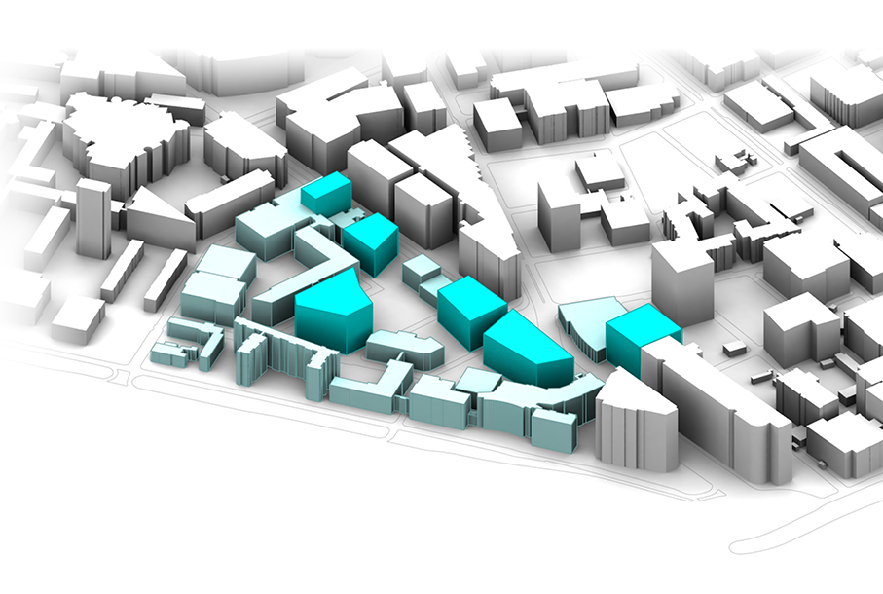
The Town Energy Balance (TEB): An urban surface parametrization developed at Météo France
2017-04-21 课题组讨论会
曾繁兴

Slide 2
Outline
Motivation for the development of the Town Energy Balance (TEB)
Fundamentals of TEB
Meteorological forcing data
Applications for urban climate studies
The CAPITOUL campaign and simulation results

Slide 3
Motivation for the development of the Town Energy Balance (TEB)

Slide 4
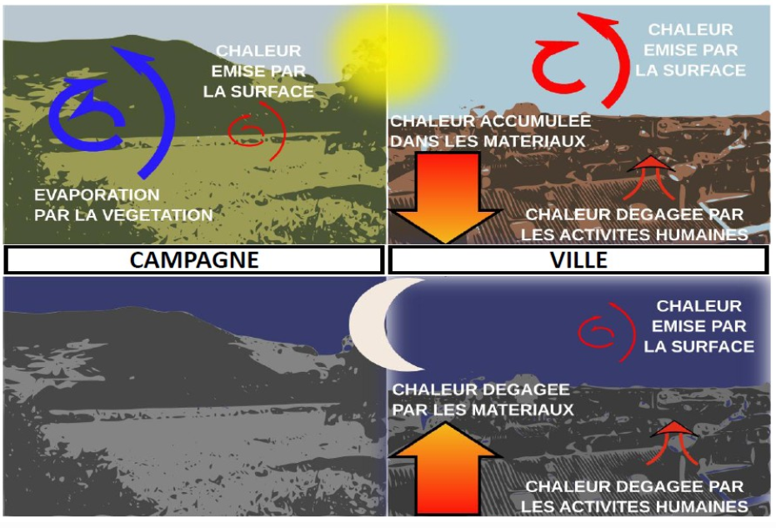
Surface energy, water and momentum balance depends on land use type
Figure De Munck (2013)

Slide 5
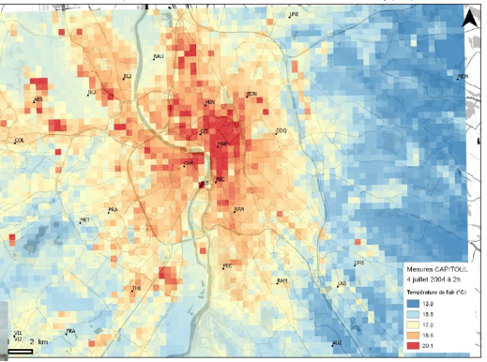
Surface energy balance impacts local climate
Differences between urban and rural climate – (Nocturnal) air temperature higher in urban area (UHI) – Relative humidity lower in urban area – Absolute humidity can be higher in urban area – Wind speed lower in urban area – Enhancement/suppression of clouds and precipitation possible
Nocturnal (2 AM) air temperature observed in Toulouse on July 4 2004 during the CAPITOUL campaign (Masson et al., 2008)
Figure De Munck (2013)

Slide 6
What is TEB made for?
Purpose and design of TEB – Urban surface energy, water, momentum balance for atmospheric models – Sensible and latent heat flux, momentum and radiation exchange – The scale of application is an urban district, not single buildings – Numerical integration must be a lot faster than for atmospheric model TEB is not designed for – Simulations at the scale of one single building – Details of the wind and temperature fields in the street canyons – Details inside the buildings

Slide 7
Fundamentals of TEB

Slide 8
TEB architecture

Slide 9
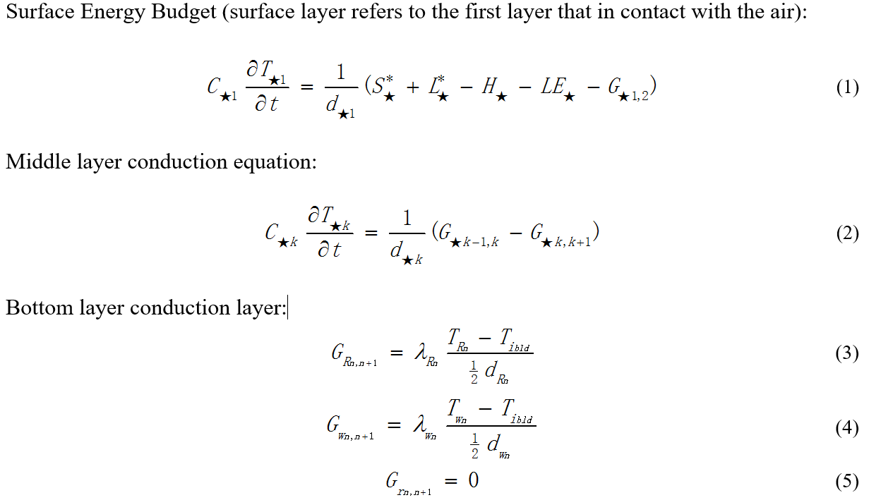

Slide 10
Meteorological forcing data

Slide 12
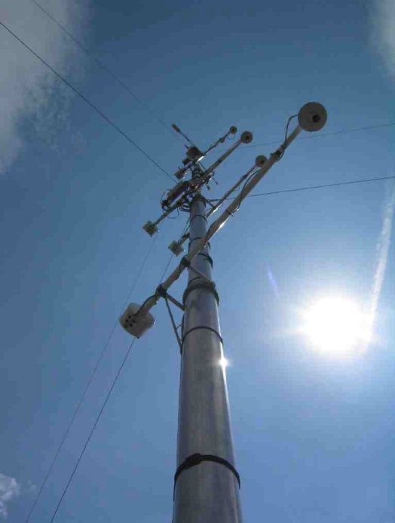
Required meteorological forcing data – Air temperature and specific humidity – Wind speed and direction – Air pressure – Direct and diffuse downwelling solar radiation – Downwelling infra-red radiation – Rain and snow fall rate

Slide 13
The CAPITOUL campaign and simulation results

Slide 14
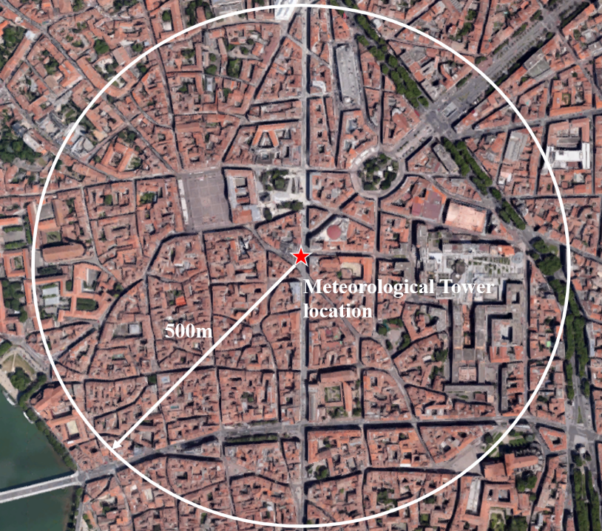
The CAPITOUL campaign -Canopy and Aerosol Particles Interaction in TOulouse Urban Layer
-Conducted over the city of Toulouse, France to quantify thermal dynamical processes and surface-atmosphere interaction within urban boundary layer
-during February 2004 to March 2005.
-The observational network includes a city centre tower equipped with a complete surface energy balance measurement system and 20 stations over the Toulouse agglomeration

Slide 15
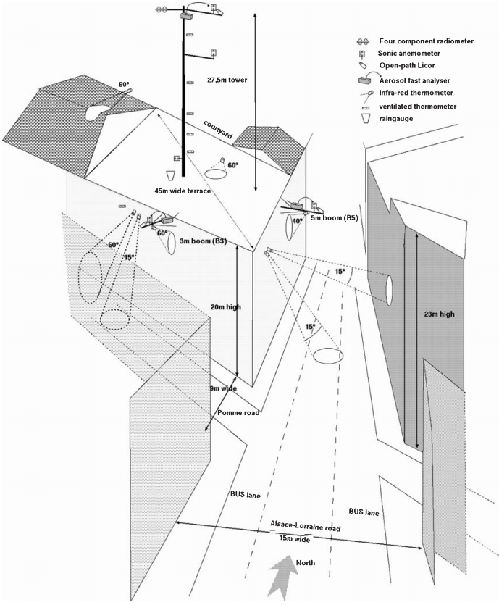
Schematic view of the central site Masson, V.,Gomes, L. et al.2008

Slide 16
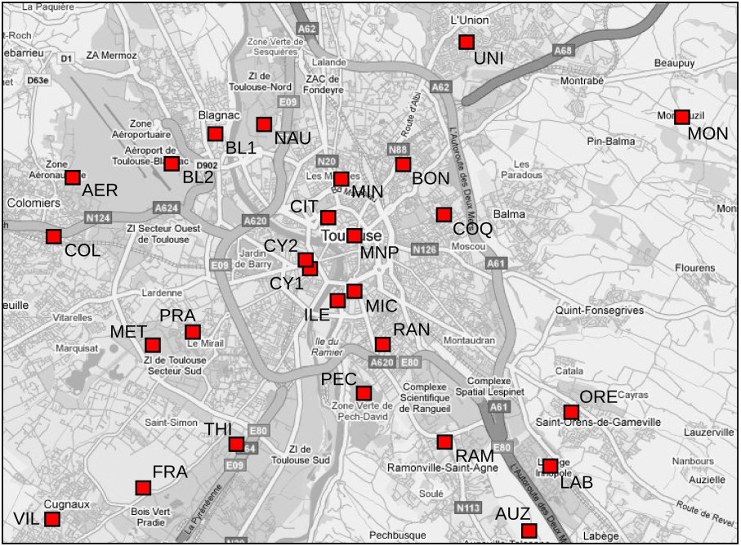
Map of the temperature stations network
Grégoire Pigeon and Valéry Masson, 2009

Slide 17
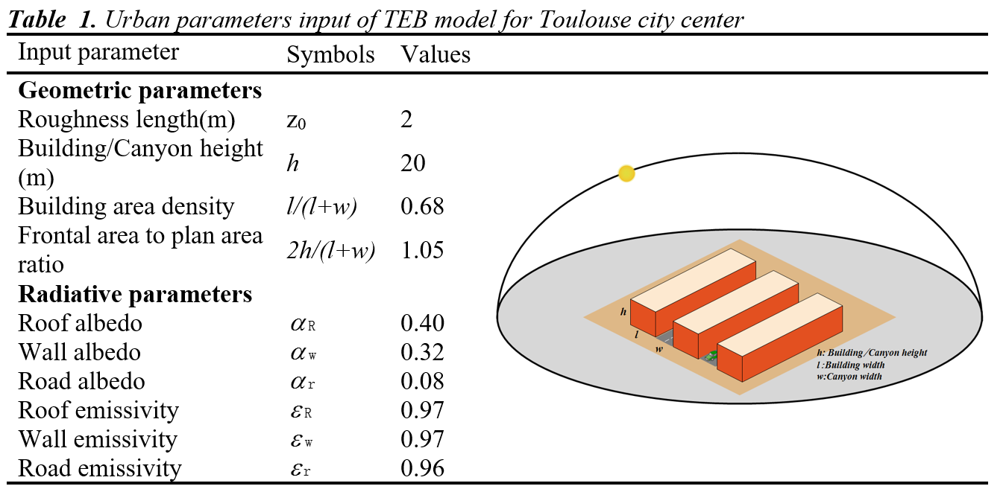

Slide 18
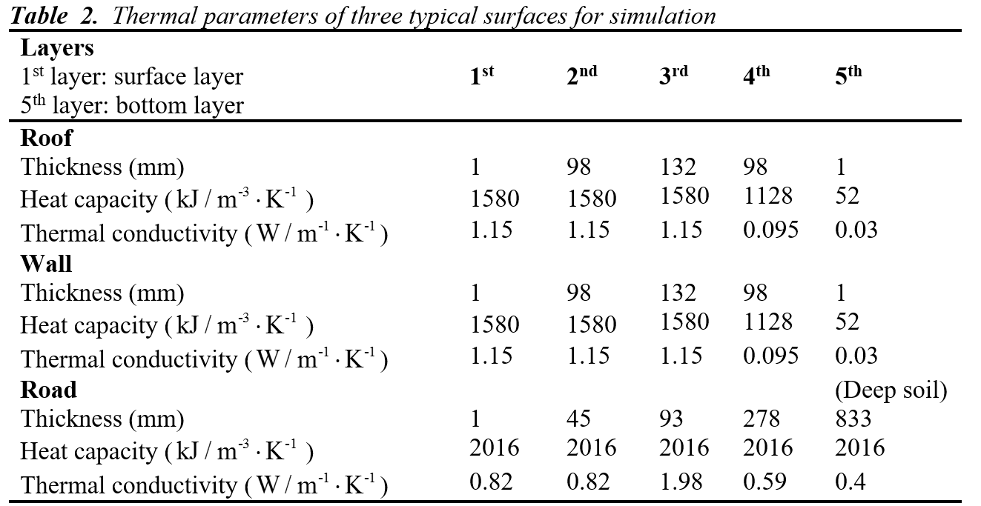

Slide 19
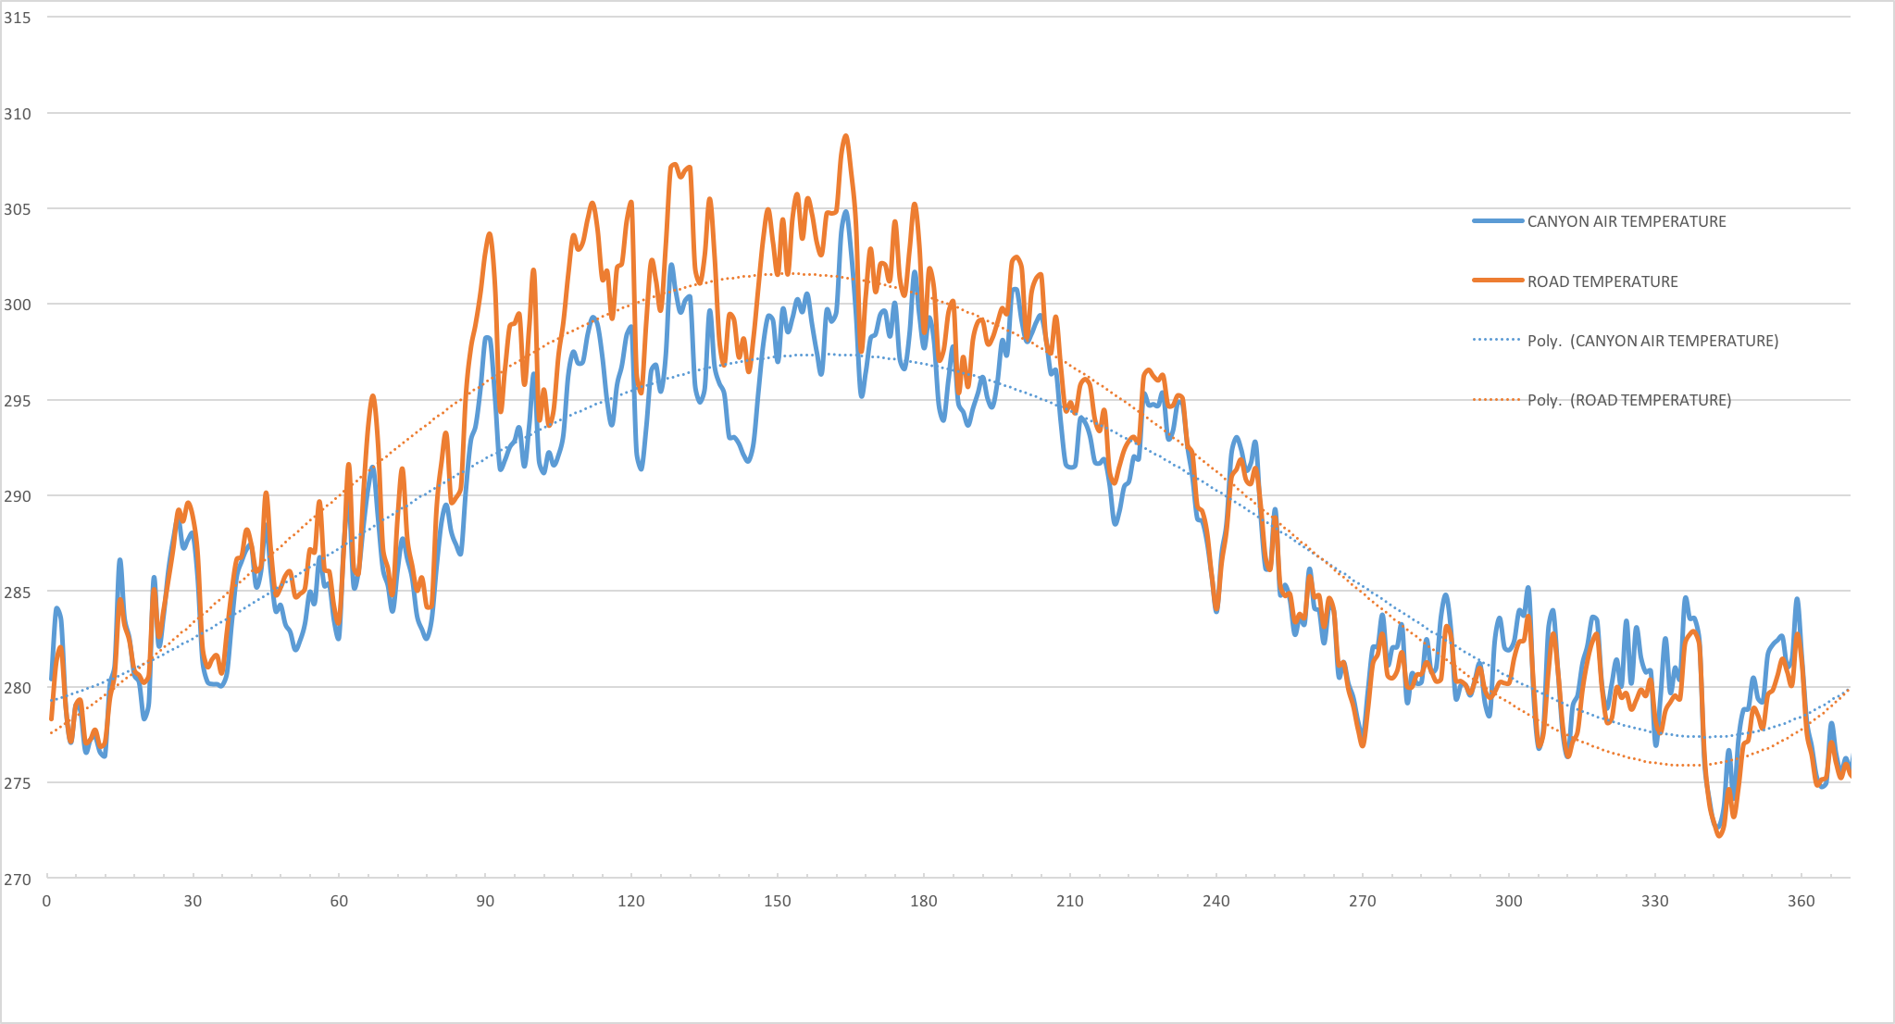
Annual temperature cycle from TEB simulation

Slide 20
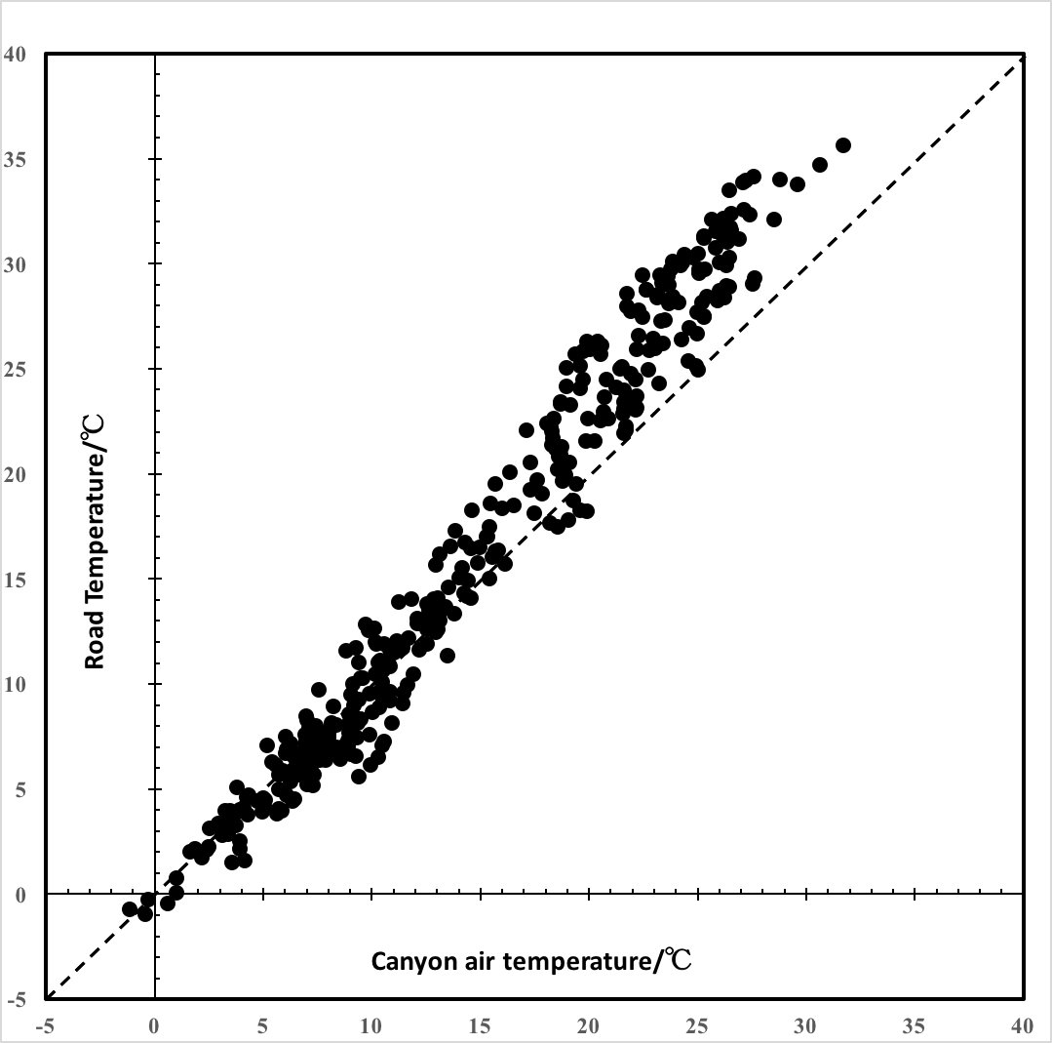
Ensemble-averaged temperature cycle for seven days （2004.7.25-7.31）under anticyclone weather

Slide 21
Conclusions
-For the analysis of urban microclimate, the main weakness of energy balance models is that the velocity field is not directly modelled. On the other hand, in CFD, velocity field can be coupled with temperature field. Therefore, CFD has the potential to be an important tool for the deterministic analysis of urban microclimate and consequently for the analysis of adaptation measures in building and urban scale.
-After defining the objective of study, the degree of complexity included in the models and computational cost of the case are the principal constraints in a reliable urban microclimate simulation which need to be properly dealt with in the future study.

Slide 22
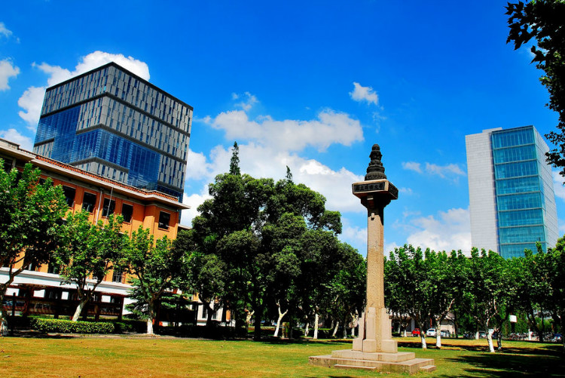
The end
谢谢各位！

